Slide 1
Introduction
Overview of SharePoint

Slide 3
How to View This Presentation
To switch to Notes Page view:
To navigate through notes, use the Page Up and Page Down keys
Zoom in or zoom out, if required
In the Notes Page view, you can:
Read any supporting text—now or after the delivery
Add notes to your copy of the presentation, if required
Take the presentation files home with you
While in edit mode, click the View tab within the ribbon, and then click Notes Page

Slide 4
Objectives
Learn about the evolution of SharePoint & Development
Get an understanding of the role of the Add-In model
Understand the new concepts and features added to SharePoint code platform in SharePoint
Be aware of the deprecated features in SharePoint
Notes:
Note to presenter: be sure to just cover the basics of each topic in this slide deck.
This slide deck is meant to inform your students about the topics that will be covered during the training.
Each topic mentioned in this slide deck will be discussed in greater depth later on.

Slide 5
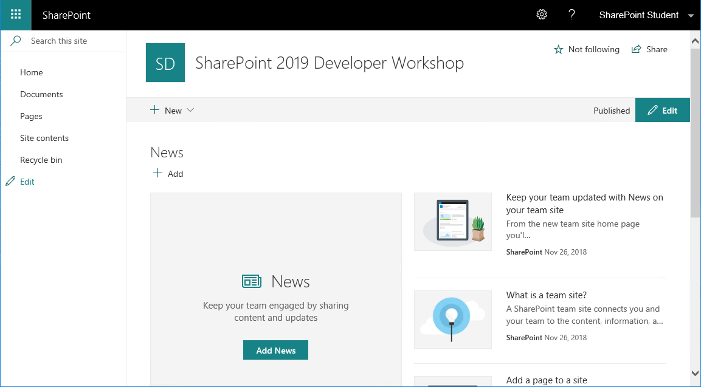
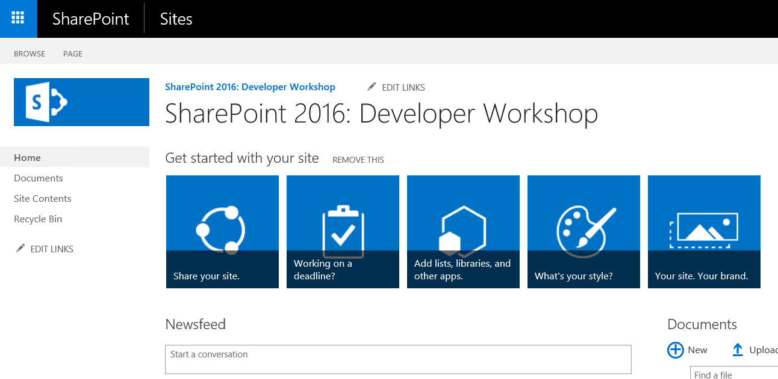
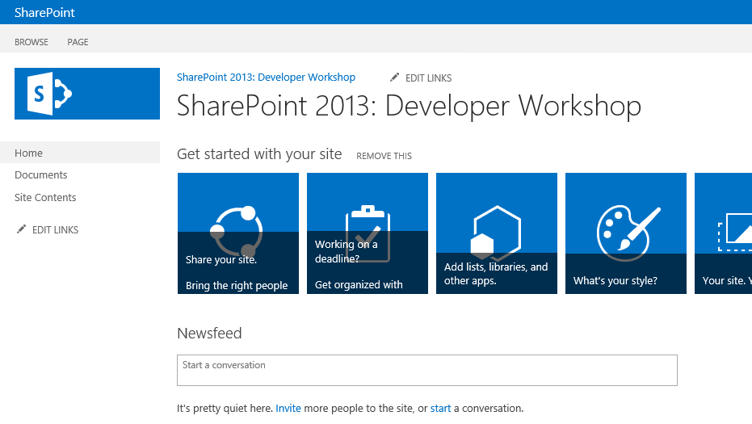
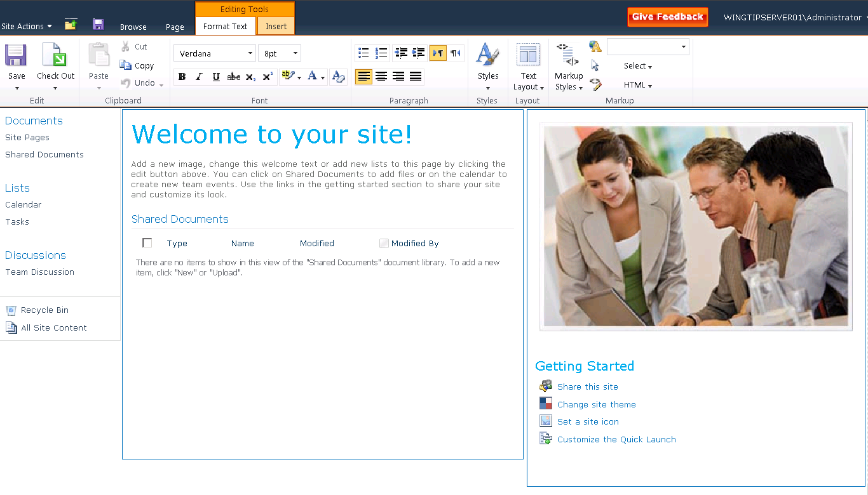
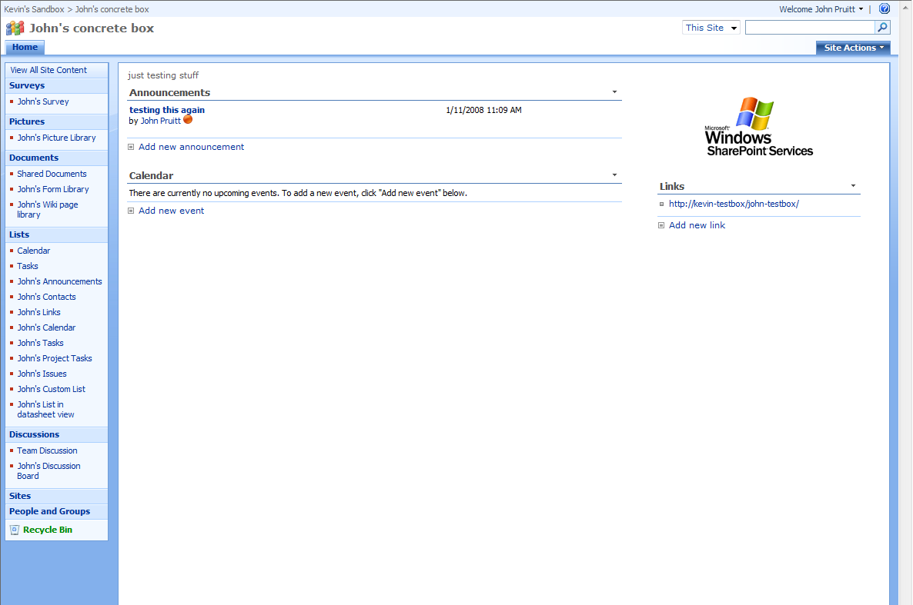
Evolution of SharePoint
Notes:
The UI of SharePoint has undergone quite some changes in the past. Notice how the UI is getting richer with each version. SharePoint 2010 added the Ribbon. In SharePoint 2013 tiles were introduced. SharePoint 2016 brought us the App Launcher also known as the waffle menu and in SharePoint 2019 we introduced the modern experience.

Slide 6
Evolution of SharePoint Development
Microsoft Office SharePoint Server 2007
Farm Solutions
Custom code runs in process
High risk for faulty code
Remote calls via SOAP web services and WCF endpoints
Microsoft .NET 2.0
Notes:
2007
Custom code was implemented on server level, all went into the GAC / farm wide deployed
High risk for faulty code to bring servers down
New solution and feature packages (Now WSP vs. Dwp packages) but still running with full trust (in-process)

Slide 7
Evolution of SharePoint Development
SharePoint 2010
Farm Solutions or Sandboxed Solutions
Custom code runs in process or in sandboxed process
Still high risk for faulty code
Remote calls via SOAP web services, WCF endpoints or CSOM/JSOM
Microsoft .NET 3.5
Notes:
2010
Added sandbox solutions (out of process)
More secured code execution, securing Frontend server web services
CSOM (Client side object model) implemented, moving load from server to client
More options on client side that wasn‘t possible before (2007 = Java Scripting on client side)

Slide 8
Evolution of SharePoint Development
SharePoint 2013
Add-In is the preferred model
New REST endpoints introduced
CSOM capabilities enhanced
Protection against faulty code
Farm Solutions and Sandboxed solutions still possible
Microsoft .NET 4.5
Notes:
2013
New API model
Communication between server and client via standard web technologies
Custom code does not rely on server side anymore, very high protection level against „bad code“
New Add-In model takes the sandbox idea to a new level and enables easy to develop custom solutions to run in their own isolated domain

Slide 9
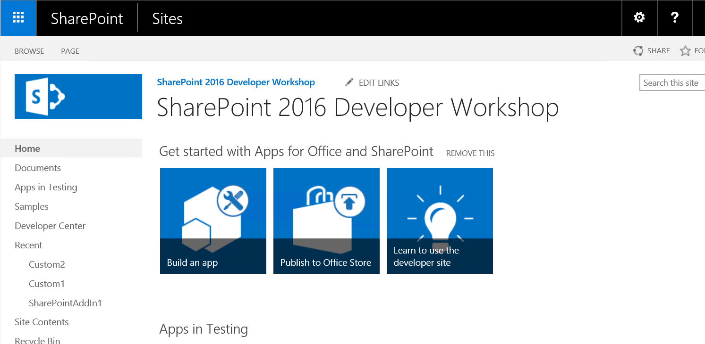
Evolution of SharePoint Development
SharePoint 2016
Extended API for Add-ins
Farm Solutions and Sandboxed solutions still possible
API Types; SSOM, CSOM, REST, PowerShell
SharePoint Framework WebParts v1.1.0 added in Feature Pack 2
Microsoft .NET 4.6
Notes:
In SharePoint 2016 we‘re seeing further evolution of the Add-In model. Yet even more APIs have been added. The experience and improvements gained from running world‘s biggest SharePoint Farm: SharePoint Online was used to build SharePoint 2016 for on premises usage by branching off from the same source code as used for SharePoint Online.
For companies that have invested time and money into building Full Trust Code and/or sandboxed solutions there is good news: these will remain to be supported in SharePoint 2016 as they were in 2013.
Server Side Object Model (SSOM), Client Side Object Model (CSOM), Representative State Transfer (REST) and PowerShell are still your options for interacting with SharePoint from custom code, as was the case in SharePoint 2013.
As of September 2017, SharePoint Framework is also available in SharePoint Server 2016 supporting only Client Side Web Parts. Note also that the SharePoint Framework will never become available for SharePoint 2013 or older versions nor will it recieve a version update.

Slide 10
Evolution of SharePoint Development
SharePoint 2019
Farm Solutions still possible
SharePoint Framework v1.4.1 WebParts and Extensions
Sandboxed solutions declarative only
Modern Experience
OneDrive Sync Client
ALM APIs added
Microsoft .NET 4.7.2
Notes:
SharePoint 2019 involved being based on top of what we call the modern experience. This introduces a new user interface which is responsive, much faster and no longer uses postbacks for working with your data. It also brought a new version of SPFx being v1.4.1 which introduced the SPFx Extensions to be used on-premises as well. Another new big thing for 2019 was the ability to use the OneDrive.exe sync client to synchronize your files from SharePoint 2019 to your local machines which introduces a much greater stability and reliability over the former Groove client which was still used in SharePoint 2016.
Also in SharePoint 2019, the ALM APIs were introduced which allows automation of the deployment of Add-In and SPFx packages to your SharePoint environment. More on this in a later module.

Slide 11
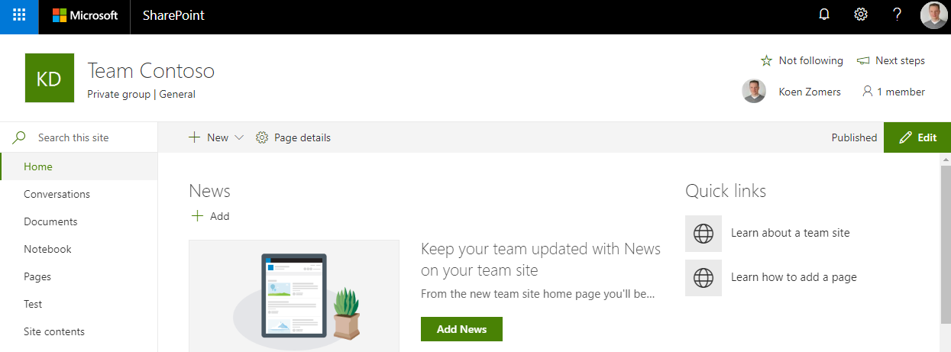
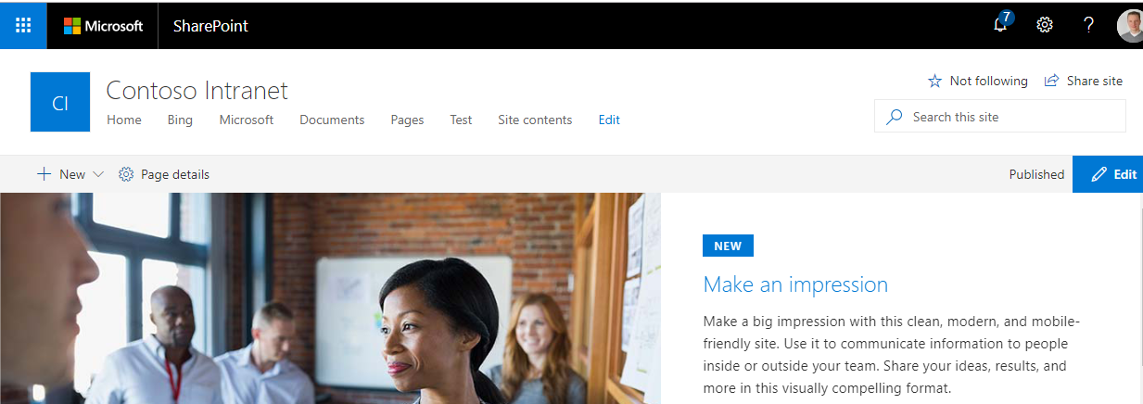
Evolution of SharePoint Development
SharePoint Online
Office 365 in the lead
Coded Sandboxed solutions are no longer possible
SharePoint Framework is the way to go
Full Trust Code is not possible
Modern Pages are taking over
SharePoint Add-In Model can still be used as well
Notes:
New functionality gets added to SharePoint Online first and then may or may not later be included in future releases or updates for SharePoint On Premises. One example of that would be the waffle menu on the top left. It was first added to SharePoint Online and then was released with SharePoint 2016 for On Premises and the July 2016 Cumulative Update for SharePoint 2013 also brought the waffle menu to that version. SharePoint 2019 also introduced some of the modern experience components we had been using in SharePoint Online for some time already.
The Product Group is working on replacing SharePoint pages with what they call Modern Pages. This can be seen already at the Site Contents view and when viewing a list or library. The classic view will remain supported for the foreseeable future and customers are free to switch back from the automatically enforced modern pages view to the classic view where possible, but new features are likely not going to be released for the classic view, like Microsoft Flow and Microsoft PowerApps integration.
Full Trust Code has never been possible on SharePoint Online. Also sandboxed solutions containing code are no longer possible after August 31, 2016. Since 2014 we already announced that this was to happen. That effectively leaves you with the Add-In model and SPFx for your customizations in SharePoint Online. We‘ll learn a lot more about this in this workshop.
We see that the SharePoint Framework gets regular updates on SharePoint Online. Besides that, new functionality like the SPFx Extensions also get introduced on a regular base. SharePoint 2016 only supports the SPFx WebParts, whereas SharePoint 2019 also supports SPFx Extensions to be used.

Slide 12
Development models
Available where?
 | MOSS 2007 | SP 2010 | SP 2013 | SP 2016 | SP 2019 | SP Online
Farm Solutions | Yes | Yes | Yes | Yes | Yes | No
Sandboxed Solutions* | No | Yes | Yes | Yes | Yes** | Yes**
SharePoint Add-ins | No | No | Yes | Yes | Yes | Yes
SharePoint Framework | No | No | No | Yes (v1.1.0) | Yes (v1.4.1) | Yes (latest)
* Is currently and deprecated and may be removed in future on-premise versions
** Declarative still supported, custom code has been removed
Notes:
Four main development models exist for SharePoint on-premises and cloud. While the custom code part of Sandboxed Solutions has been deprecated, the other three are still generally supported. SharePoint Add-ins and SharePoint Framework are the recommended models for extending SharePoint.

Slide 13
Knowledge Check
In what version is Full-Trust Code not supported?
Which version of SharePoint introduced CSOM?
Which version of SharePoint introduced the Add-Ins?
SharePoint Online
SharePoint 2013
SharePoint 2010
SharePoint Online
SharePoint 2013
SharePoint 2010
SharePoint Online
SharePoint 2013
SharePoint 2010
Which versions of SharePoint support using SPFx?
SharePoint 2013
SharePoint 2016
SharePoint 2019
Notes:
Answers:
SharePoint Online
SharePoint Server 2010
SharePoint Server 2013
SharePoint 2016 & 2019

Slide 14
Knowledge Check
In what version is Full-Trust Code not supported?
Which version of SharePoint introduced CSOM?
Which version of SharePoint introduced the Add-Ins?
SharePoint Online
SharePoint 2013
SharePoint 2010
SharePoint Online
SharePoint 2013
SharePoint 2010
SharePoint Online
SharePoint 2013
SharePoint 2010
Which versions of SharePoint support using SPFx?
SharePoint 2013
SharePoint 2016
SharePoint 2019
Notes:
Answers:
SharePoint Online
SharePoint Server 2010
SharePoint Server 2013
SharePoint 2016 & 2019

Slide 15












Add-in model
Add-in model
SharePoint Framework
Web Standards
Core Platform
Workflow
Search
Mobility
Web Content Management
Social
Service Applications
Deprecated

Slide 16
What is the Add-In Model
New development model introduced with SharePoint 2013
Little or no dependencies on other software on the device or platform where it is installed
Can be installed/uninstalled simply and cleanly without downtime
Installation and uninstallation is performed by end-users
Everything in SharePoint 2013 & 2016 is called an App or Add-In
Add-Ins can be distributed through the SharePoint Store (public) or the Add-In Catalog (private)
Add-In Model
Notes:
The Add-In model was introduced in SharePoint 2013. SharePoint 2016 continues with the same customization strategy. The Add-In approach means there is little to no dependency on other software, the platform or the devices where the software runs. This provides maximum flexibility and the ability to use any kind of technology you feel best suits the job at hand. No longer you’re restrained by the Microsoft .NET framework SharePoint is build on. Add-Ins can be installed and uninstalled without any downtime or loss in availability of the SharePoint platform which is a huge leap forward coming from Full Trust Code deployments. Functionality can be added by site owners without the need for a farm administrator to intervene.
Started with SharePoint 2013, everything is now an Add-In. This includes document libraries and custom lists that can be added by adding an add-in in SharePoint. In 2016, they’ve applied the same naming convention. In SharePoint Online however, we have seen changes to go back to the original naming where you can choose to add a List, Document Library, App, etc. again. The same we’re seeing in SharePoint 2019: they’re taking things apart again and naming them by their original names.
Add-Ins can be added to and distributed via the public SharePoint Store or via the enterprise Add-In Catalog.
More on these topics later in the workshop.

Slide 17
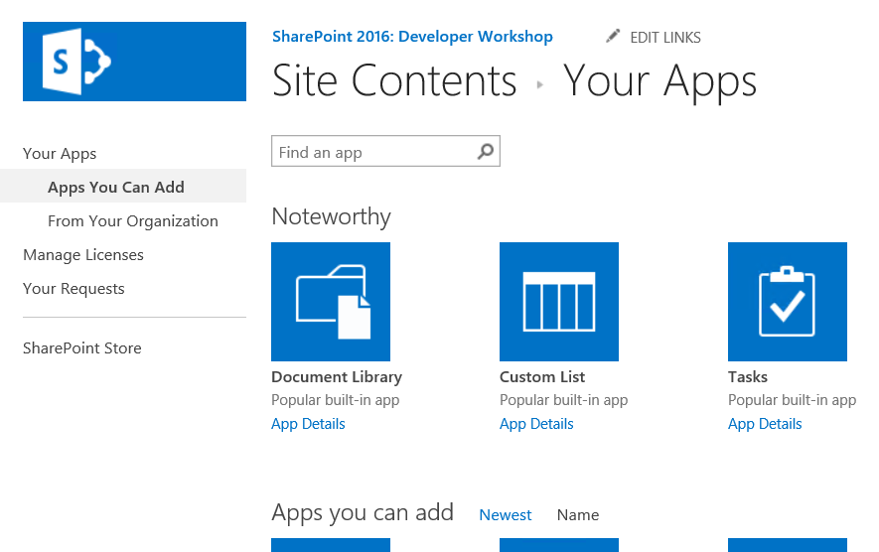
Add-In Model
Discover IT Approved Add-Ins in the App Catalog
Track Add-In requests and manage licenses
Access the SharePoint and Office store
Notes:
Developers will be able to publish their Add-Ins to the public SharePoint Store for download & purchases.
In addition organizations will be able to create a private corporate marketplace where the Add-Ins would be available to the organization.

Slide 18
SharePoint Framework
Add-in model
SharePoint Framework
Web Standards
Core Platform
Workflow
Search
Mobility
Web Content Management
Social
Service Applications
Deprecated

Slide 19
What is SharePoint Framework?
New development model introduced in SharePoint Online
SharePoint Framework (SPFx)
Also available in SharePoint Server 2016 since Feature Pack 2 (September 2017 CU) and available in SharePoint 2019
Build Client-Side Web Parts for SharePoint Online and SharePoint On Premises (2016/2019)
Build Extensions for SharePoint Online and SharePoint 2019
Develop cross platform using open source web technologies and tools
Notes:
SharePoint Framework is being referred to as SPFx in short
It was first introduced in SharePoint Online on the 23rd of February 2017 when version 1.0 became Generally Available
Support for SPFx was added in SharePoint 2016 by installing feature pack 2 which was included in the September 2017 Cumulative Update for SharePoint 2016
In SharePoint 2016 and 2019 you can build web-parts, in 2019 you can additionally build extensions and in online you can also build other modern SPFx features
SPFx solutions can be built on any platform (PC, Mac, Linux, etc) and used open source technologies

Slide 20
Web Standards
Add-in model
SharePoint Framework
Web Standards
Core Platform
Workflow
Search
Mobility
Web Content Management
Social
Service Applications
Deprecated

Slide 21
Web Standards
OAuth 2, JWT & Bearer tokens
OAuth enables users to provide specific permissions to an Add-In
No username/password needs to be provided or stored
Add-In can still perform actions as the user but can also elevate above the user
Authentication passed to SharePoint via a JWT as the bearer token
Notes:
OAuth uses an app identifier (Client ID) plus a secret key (Client Secret) or signing certificate to create a trust between an application and server which allows issuing of an OAuth token that enables password-less authentication between the user and application
The Application using OAuth never needs to know or store the user’s SharePoint password
OAuth is a form of application authentication and allows for both authenticating as an application and authenticating as an application on behalf of a user
This allows us to do Server-To-Server authentication
We use it to give Add-Ins different permissions from what the user has
Authentication towards SharePoint happens by providing the Authentication header in the request having a Bearer JWT (pronounced JOT, stands for Jason Web Token)
Only supported on the _api and /vti_bin/client.svc endpoints of SharePoint
More on this topic in the security module later in this workshop

Slide 22
Web Standards
REST & JSON
Communication with SharePoint via RESTful services
Use any library from any platform to work with SharePoint externally
Host your code on any platform
Write your code in any technology
Notes:
REST & JSON are used to communicate with SharePoint
Any library available for making webrequests can be used to communicate with these endpoints. Whether you use i.e. native Fetch, jQuery Ajax, a HttpClient in C# or cUrl, anything can be used.
Your code can be hosted on any kind of platform such as Azure Websites, Microsoft IIS, NodeJs, Apache or any other web hosting platform.
It does not matter anymore in what language you write your code, as the communication with SharePoint happens through the open web standards making it independent from how SharePoint works

Slide 23
Core Platform
Add-in model
SharePoint Framework
Web Standards
Core Platform
Workflow
Search
Mobility
Web Content Management
Social
Service Applications
Deprecated

Slide 24
Core Platform
Add-Ins and SharePoint Framework components connect to SharePoint using
SharePoint Client Side Object Model (CSOM)
SharePoint REST API
Main investments in 2016
SharePoint Framework v1.1.0
Information Rights Management API
Batching API Requests
Main investments in 2019
WebHooks
Modern Pages
Files API introduced
SharePoint Framework v1.4.1 adding extensions
Notes:
Interaction with SharePoint can be done via CSOM and the REST API. JSOM is no longer being developed (https://docs.microsoft.com/en-us/sharepoint/dev/spfx/web-parts/guidance/connect-to-sharepoint-using-jsom#considerations).
Main investments API wise in SharePoint 2016 have been in the areas of:
Files API: it is now easier to interact with files stored on SharePoint 2016. I.e. get previous versions or create guest links to share a file.
Information Rights Management (IRM) API: more functionality is exposed through the APIs to enable and configure IRM on SharePoint content
SharePoint Framework support (requires Feature Pack 2)
Batching requests
For more information, see: http://sharepointfieldnotes.blogspot.nl/2016/01/whats-new-in-sharepoint-2016-remote-api.html
SharePoint 2019 added support for WebHooks (https://docs.microsoft.com/en-us/sharepoint/dev/apis/webhooks/overview-sharepoint-webhooks), introduced modern pages and upgraded the support for SharePoint Framework (SPFx) to version 1.4.1 which effectively means it also supports SPFx extensions.

Slide 25
Knowledge Check
Which platforms allow us to create SPFx Extensions?
Which SharePoint version(s) allows using Webhooks?
SharePoint 2013
SharePoint 2016
SharePoint 2019
SharePoint 2016
SharePoint 2019
SharePoint Online
Notes:
The correct answers are:
SharePoint 2019 and Online
SharePoint 2019

Slide 26
Knowledge Check
Which platforms allow us to create SPFx Extensions?
Which SharePoint version(s) allows using Webhooks?
SharePoint 2013
SharePoint 2016
SharePoint 2019
SharePoint 2016
SharePoint 2019
SharePoint Online

Slide 27
Workflow
Add-in model
SharePoint Framework
Web Standards
Core Platform
Workflow
Search
Mobility
Web Content Management
Social
Service Applications
Deprecated

Slide 28
Workflow
Workflow
SharePoint 2013 Workflows utilizing Workflow Manager
SharePoint 2010 Workflows Engine is still present in SharePoint
Custom functionality can be added to a workflow by hosting it as a webservice outside of SharePoint and calling it from a SharePoint 2013 Workflow
Microsoft Flow can be utilized in a hybrid setup through the On-Premises Data Gateway
Notes:
No changes to the way SharePoint 2013/2016 workflows are operating have been done in SharePoint 2016 and 2019. The new model of running workflows in Workflow Manager, outside of SharePoint, which was introduced in SharePoint 2013, also applies to SharePoint 2016 and 2019.
As workflows run in Workflow Manager, it is no longer running inside the SharePoint process, thus can’t have any negative impact on the performance of SharePoint as a whole anymore
Workflow is now XAML based
Fully declarative, so no custom code is allowed anymore
Custom operations not being available as an out of the box action can be developed in a custom built webservice which can be triggered from a workflow
Developing Workflows in Visual Studio and SharePoint Designer is a similar experience in SharePoint 2016 and 2019 as it was in SharePoint 2010 and 2013
You can still extend the functionality that SharePoint workflows offer out of the box. This can be done by hosting your custom functionality inside a webservice you build using i.e. ASP.NET WebApi or Odata and triggering this webservice from a SharePoint 2013 Workflow.
Both the SharePoint 2010 and SharePoint 2013 engines have been updated in SharePoint 2016 and 2019 to be more reliant and stable. They will keep their names however. They will not be renamed to SharePoint 2016 or 2019. More info: https://technet.microsoft.com/en-us/library/jj219638(v=office.16).aspx
It is possible to use Microsoft Flow in Office 365 to run workflows which consume data from your on-premises SharePoint environment. For this to work, you will need to install and set up the Microsoft On Premises Data Gateway. More information: https://docs.microsoft.com/en-us/flow/gateway-reference

Slide 29
Search
Add-in model
SharePoint Framework
Web Standards
Core Platform
Workflow
Search
Mobility
Web Content Management
Social
Service Applications
Deprecated

Slide 30
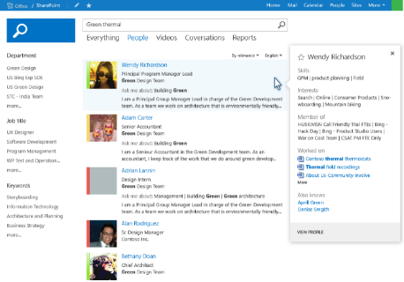
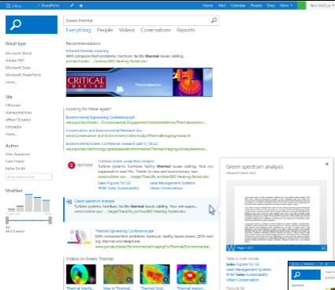
Search
Inherited from SharePoint 2016
Inherited from SharePoint 2013
Personalized search results based on history
Keyword Query Language main option for building queries
APIs to leverage search results externally
Continuous crawl for SharePoint content sources
500 million items per Search Service Application
Improvement in SharePoint 2019
Modern Search Experience
Notes:
SharePoint 2019 did not provide any significant updates to the search functionality other than patches and stability updates. It did introduce the modern Search Experience which can be used by going to SharePoint Home and using the search box at the top left corner. At this moment this search experience cannot be customized yet and it will use the default search scope to return results.
SharePoint 2016 has only changed the internals of the search functionality in SharePoint. These changes now make it possible to index up to 500 million items per Search Service Application. Other than that, there are no changes to search in SharePoint 2016.
SharePoint 2013 introduced quite a few changes related to search in SharePoint. Those changes still apply to SharePoint 2016 and 2019. Some of them being:
Personalized search results As the analytics service is incorporated with SharePoint search, it is able to fine-tune search results down to the person performing the search query. This may mean that when person A executes exactly the same query as person B, that they both get different results or the results will be shown in a different order. Ensure your users are aware of this functionality. There may be confusion due to a difference in their interests and previously visited sites and documents in SharePoint.
Keyword Query Language (KQL) defines how to build queries against the SharePoint search engine. KQL is the main syntax that should be used to perform search queries.
APIs for search are available to make use of the powerful search engine in SharePoint 2016 to retrieve fine tuned, sorted and filtered data to be shown in external applications.
Continuous crawl is still available and optimizes search data freshness. In other words newly added or updated content will be visible sooner in the search results. Be aware that continuous crawl is only available for content stored within SharePoint.

Slide 31
Mobility
Add-in model
SharePoint Framework
Web Standards
Core Platform
Workflow
Search
Mobility
Web Content Management
Social
Service Applications
Deprecated

Slide 32
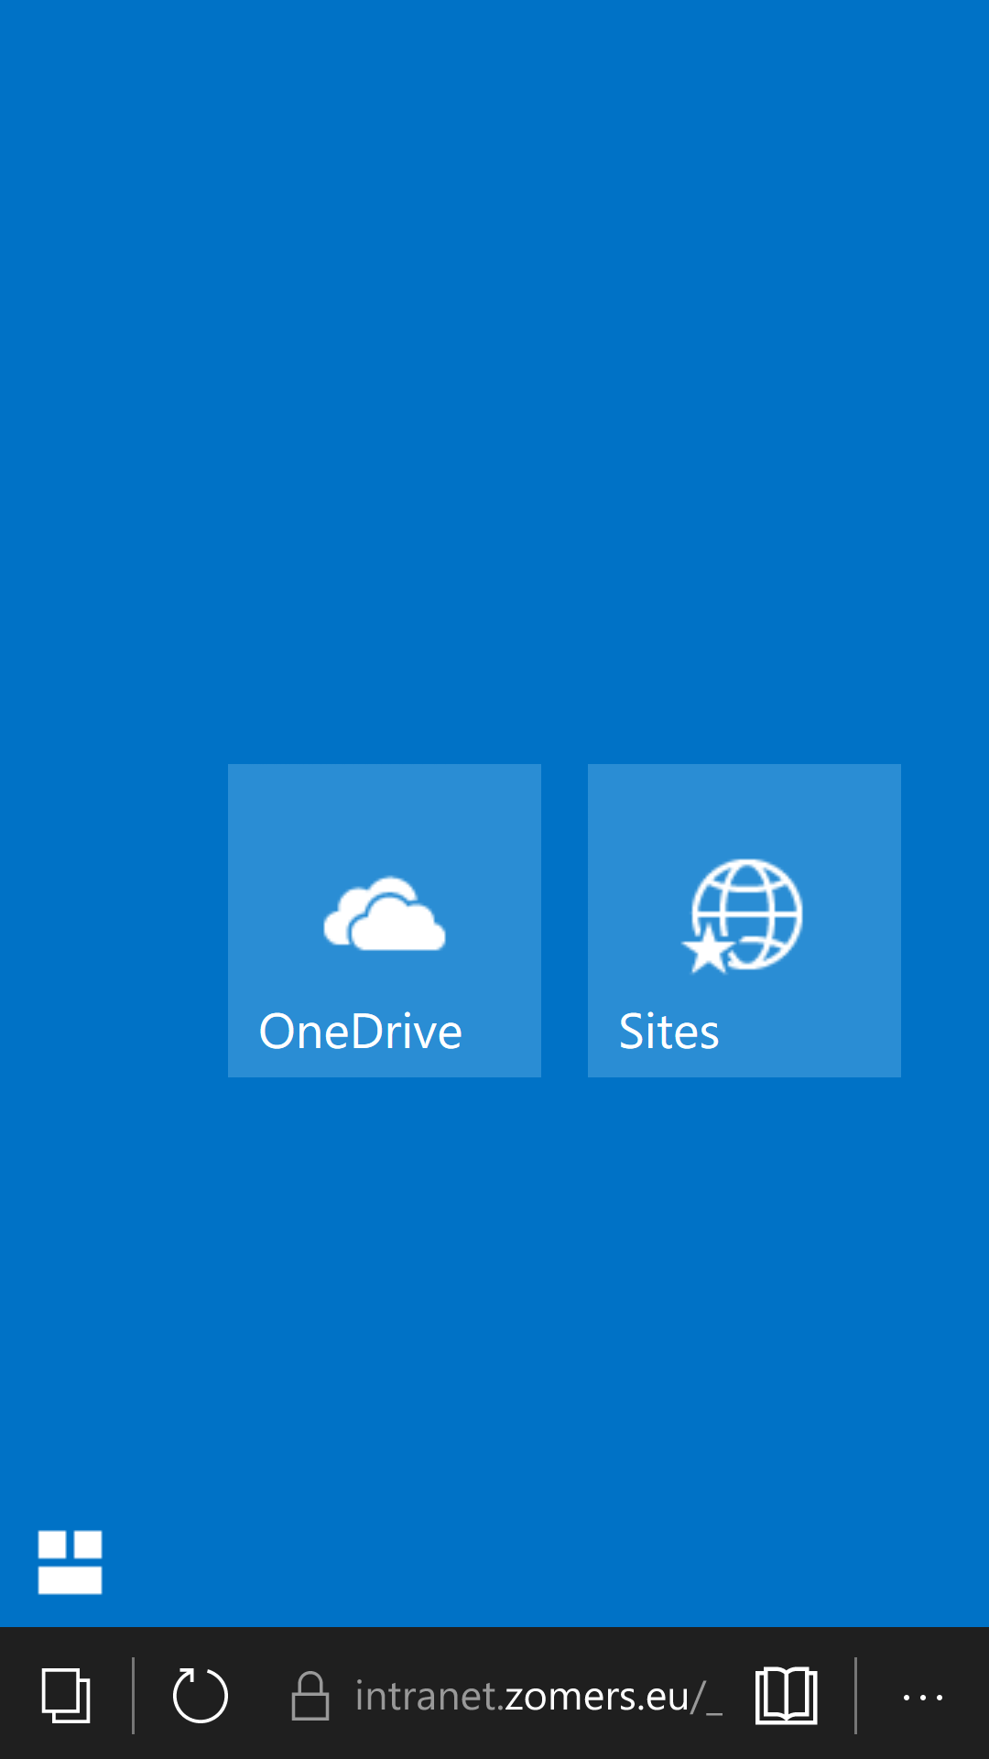
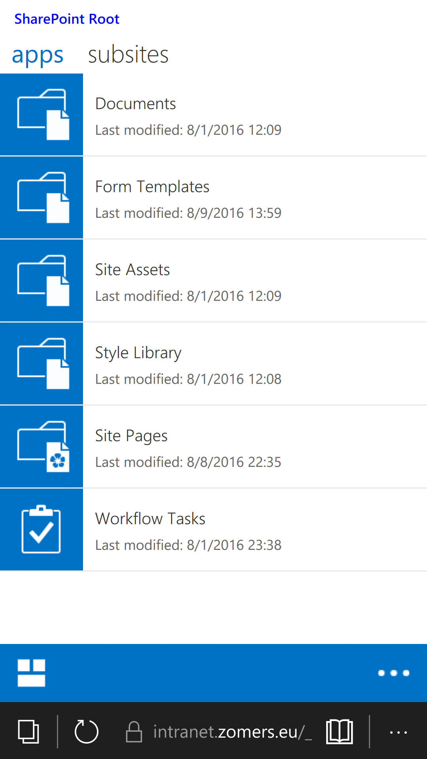
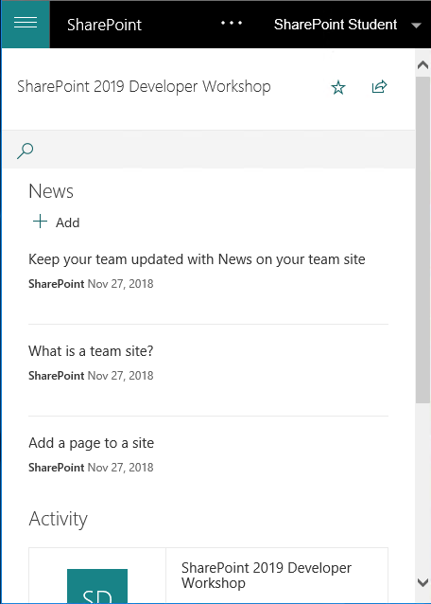
Mobility
Mobile view to allow for better experience on smaller screens Classic Experience Modern Experience
Notes:
When you use a mobile device to access the home page for a classic page in SharePoint 2019 or anywhere in a SharePoint Server 2016 team site, you can tap tiles or links on the screen to navigate the site. You can also switch from the mobile view to PC view, which displays site pages as they are seen on a client computer. This view is also touch enabled.
The modern experience in SharePoint 2019 offers truly adaptive rendering of the page making it display all the content suited for a smaller screen.

Slide 33
Web Content Management
Add-in model
SharePoint Framework
Web Standards
Core Platform
Workflow
Search
Mobility
Web Content Management
Social
Service Applications
Deprecated

Slide 34
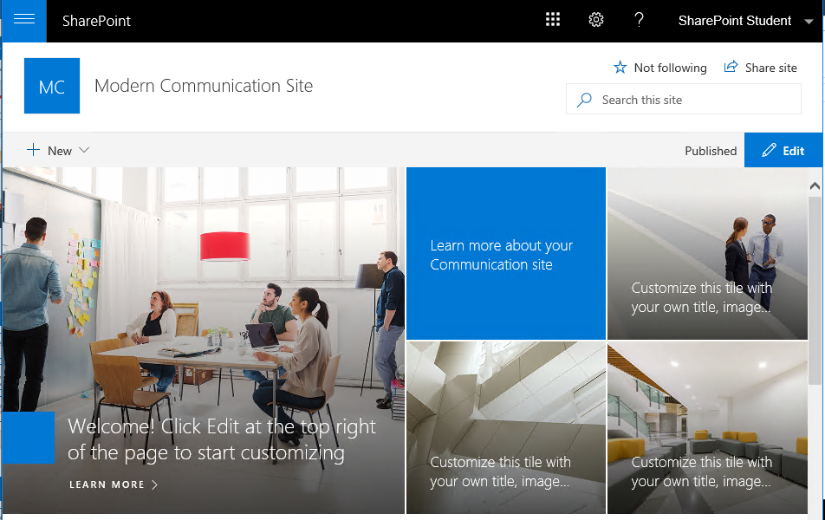
Web Content Management
Shifting from classic Publishing Features to Modern Communication Sites
Notes:
With SharePoint 2019 and Online we’re moving away from the classic Publishing Features we have known for many years in SharePoint and are moving on to modern communication sites that are responsive and give your intranet a modern appearance.

Slide 35
Knowledge Check
How many Search Items per Service Application
500 Million Items
250 Million Items
1 Billion Items
Mobile View allows for
Faster Page Load
Better Experience on Smaller Screens
Fast Page Navigation
Which Workflow engines exist
SharePoint 2010
SharePoint 2013
SharePoint 2019
Notes:
Correct answers:
500 million items
Better Experience on Smaller Screens
SharePoint 2010 & 2013

Slide 36
Knowledge Check
How many Search Items per Service Application
500 Million Items
250 Million Items
1 Billion Items
Mobile View allows for
Faster Page Load
Better Experience on Smaller Screens
Fast Page Navigation
Which Workflow engines exist
SharePoint 2010
SharePoint 2013
SharePoint 2019

Slide 37
Social
Add-in model
SharePoint Framework
Web Standards
Core Platform
Workflow
Search
Mobility
Web Content Management
Social
Service Applications
Deprecated

Slide 38
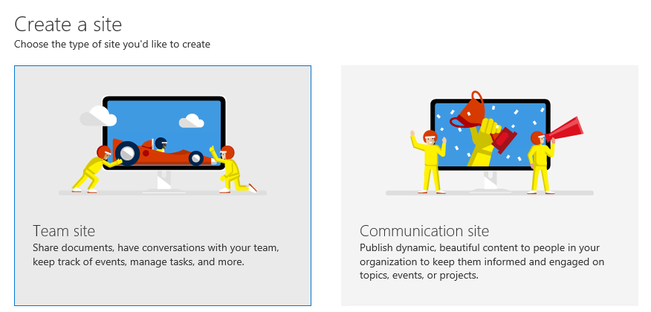
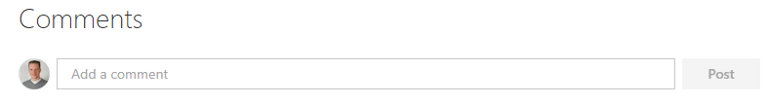
Social and Collaboration
Team Sites
Easy access to sharing content to collaborate
OneDrive for Business personal file storage
Redirects directly to storage library, there’s no shared MySite Host anymore
Uses the OneDrive Sync Client to allow offline file usage
Commenting
Fast provisioning engine
Self service site provisioning through SharePoint home to allow for easily starting to collaborate
Only available in SharePoint Online
Notes:
Team Sites
Team sites can be leveraged to set up an environment for your team to collaborate and make use of the rich feature set that SharePoint has to offer. I.e. set up a shared calendar, create custom lists, modify the look and feel of your site to give it a personal touch, customize pages to i.e. include search results specifically targeted to your project.
Since SharePoint 2013 various improvements have been made to allow for easy sharing of sites and document libraries by simply clicking the Share icon at the top right of a page.
The OneDrive Sync Client (onderive.exe) can be used to sync the documents located in document libraries inside your site to your local devices so you can work with them offline. The same sync client can also be used to synchronize files locally from team sites located on SharePoint 2019. Any earlier SharePoint version requires the use of groove.exe to allow for file synchronization.
OneDrive for Business
Allows for storing your personal files inside SharePoint. Has the same easily accessible sharing options to share your documents with your colleagues.
The shared MySite host page has been removed. Users that navigate to their OneDrive are now directly taken to their personal storage library.
When you first access your OneDrive for Business site, it will now be set up in a matter of seconds whereas it could take minutes before. This has been made possible by using a new engine inside SharePoint which simply makes a database copy of a master template instead of creating a new site collection first and then start provisioning OneDrive for Business specific functionality on top of it.
The OneDrive Sync Client (onedrive.exe) can be used to synchronize files located inside your OneDrive for Business to your local devices
Commenting
The commenting feature under a page is only available in SharePoint Online, not in on-premises

Slide 39
Service Applications
Add-in model
SharePoint Framework
Web Standards
Core Platform
Workflow
Search
Mobility
Web Content Management
Social
Service Applications
Deprecated

Slide 40
Service Applications
Infrastructural improvements
New MinRoles v2 enforces services running on proper instances
Removed Service Applications
Duet Enterprise
Excel Services
Work Management Service
Deprecated Service Applications
Access Services 2010 and 2013
InfoPath
Machine Translations
Performance Point
Site Mailbox
Code Based Sandboxed Solutions
Multi-Tenancy
Notes:
The architecture of Service Applications has remained the same as it already was in SharePoint 2010 and 2013.
A new feature called MinRoles v2 has been introduced since SharePoint 2016 which predefines which SharePoint farm servers should run which services/service applications and ensures that this will stay like this. If i.e. you enable a service on a server which MinRoles dictates shouldn’t be active on that server, it will report it as a broken topology and will eventually automatically deactivate the service on that server.
Some services have been marked as deprecated:
Access Services databases are deprecated and it is recommended not to use this technology anymore as it may be removed from a future version
InfoPath is being announced deprecated and it is recommended not to use this technology anymore as it may be removed from a future version
Machine Translations leveraged the Bing Translation API but is being marked as deprecated now
Performance Point has been marked as deprecated
Site Mailboxes allowed creation of a mailbox for a site to use as a share e-mail address for the site
Some service applications have also been removed:
Duet Enterprise: allowed you to set up integration with SAP. If you rely on this functionality, you need to stay with SharePoint 2013 Enterprise
Excel Services: this has been taken out as a service application and some of the functionality has been taken over by Office Online Server, the successor of Office Web Apps
Work Management Service: introduced in SharePoint 2013 has been removed from the product. It allowed you to synchronize your task lists within SharePoint sites to your Exchange mailbox and vice versa. This will not be returning.
Code based sandboxed solutions can not be used anymore. Declarative sandboxed solutions are still fine for now, but are also not recommended anymore.
Multi-Tenancy options have been removed

Slide 41
Knowledge Check
Which .NET Framework version is SharePoint 2019 based upon?
.NET Framework 4.7.2
Which SharePoint on-premises version introduced webhooks?
SharePoint 2019
Which three workflow engines can you use within SharePoint?
SharePoint 2010 Workflows
SharePoint 2013 Workflows
Microsoft Power Automate (using the Data Gateway Connector if having SharePoint on-premises)

Slide 42
Lesson Summary
The Add-In and SPFx Models are the preferred options for customizing SharePoint
Visual Studio is the only tool that allows creation of Add-Ins for SharePoint
SharePoint 2010 & 2013 workflows along with Microsoft Power Automate can be used in SharePoint

Slide 43
Questions

